Slide 1
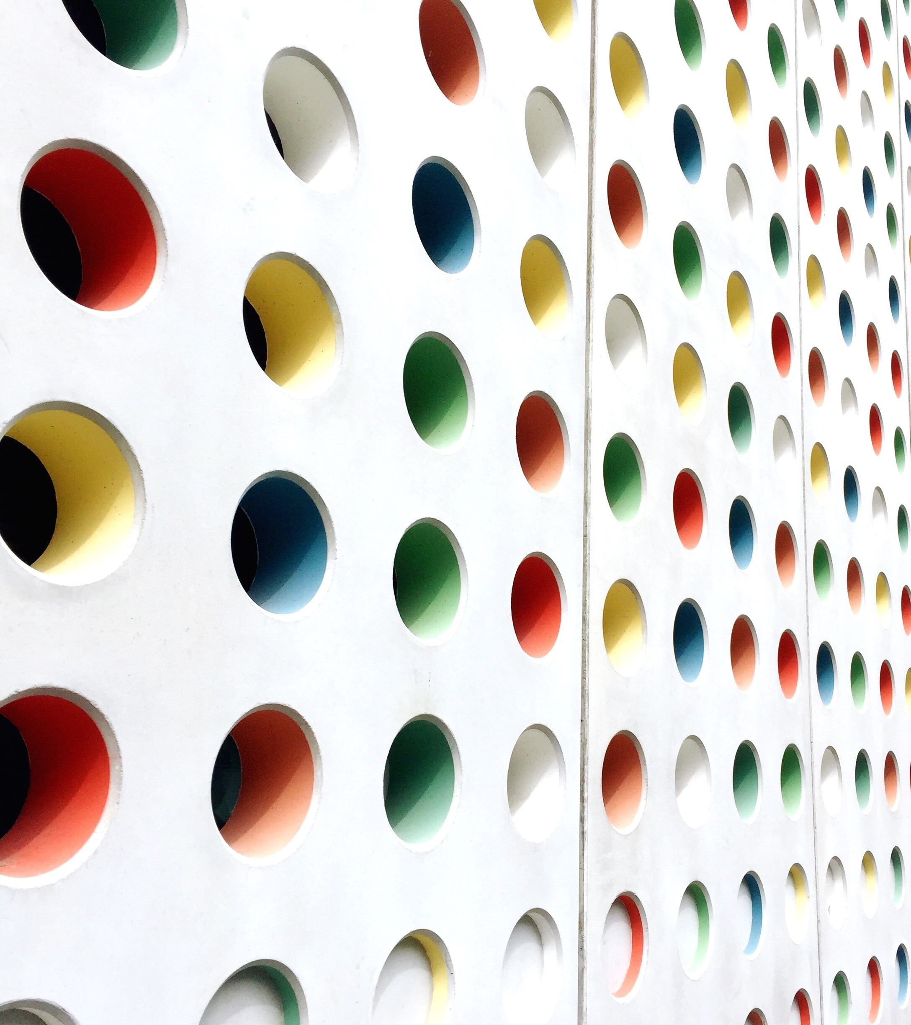

OpenCV
Sayed mohammed zahir

Slide 2
OVERVIEW
Introduction
Image
Installation
Image Processing
Video Processing
Object Detection
References

Slide 3
INTRODUCTION
Officially launched in 1999 by Intel Corporation written in C/C++
Applications include
Face recognition system
Object identification
Augmented reality
GitHub Link : https://github.com/opencv/opencv

Slide 4
IMAGE
An image is a picture that has been created or copied and stored in electronic form. An image can be described in terms of vector graphics or raster graphics. An image stored in raster form is sometimes called a bitmap. An image map is a file containing information that associates different locations on a specified image with hypertext links.
There are three main image types
Intensity image is a data matrix whose values have been scaled to represent intensities .When the elements of an intensity image are of class uint8 or class uint16, they have integer values in the range [0255] and [065535], respectively. If the image is of class double, the values are floating-point numbers. Values of scaled, class double intensity images are in the range [01] by convention.

Slide 5
IMAGE
Binary image is a black and white image. Each pixel has one logical value, 0 or 1.
Color image is like intensity image but with three channels, i.e. to each pixel corresponds three intensity values (RGB) instead of one.
Common image file formats online include;
JPEG – Joint Photographic Experts Group
GIF - Graphics Interchange Format
PNG - Portable Network Graphics
SVG - Scalable Vector Graphics
TIFF - Tag Image File Format

Slide 6
IMAGE Image Coordinate System:
Locations in an image can be expressed in various coordinate systems, depending on context
Pixel Coordinates
Spatial Coordinates

Slide 7
IMAGE Image Coordinate System:
Pixel Coordinate System
Generally, the most convenient method for expressing locations in an image is to use pixel coordinates. In this coordinate system, the image is treated as a grid of discrete elements, ordered from top to bottom and left to right.
For pixel coordinates, the first component r (the row) increases downward, while the second component c (the column) increases to the right. Pixel coordinates are integer values and range between 1 and the length of the row or column.

Slide 8
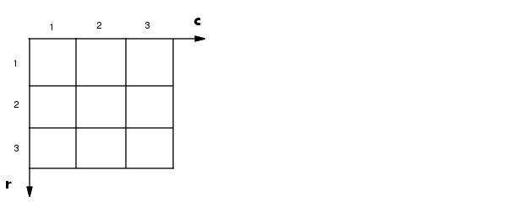
IMAGE Image Coordinate System:

Slide 9
IMAGE Image Coordinate System:
Spatial Coordinate System
This spatial coordinate system corresponds closely to the pixel coordinate system in many ways. For example, the spatial coordinates of the center point of any pixel are identical to the pixel coordinates for that pixel.
There are some important differences, however. In pixel coordinates, the upper left corner of an image is (1,1), while in spatial coordinates, this location by default is (0.5,0.5). This difference is due to the pixel coordinate system's being discrete, while the spatial coordinate system is continuous. Also, the upper left corner is always (1,1) in pixel coordinates, but you can specify a nondefault origin for the spatial coordinate system.

Slide 10
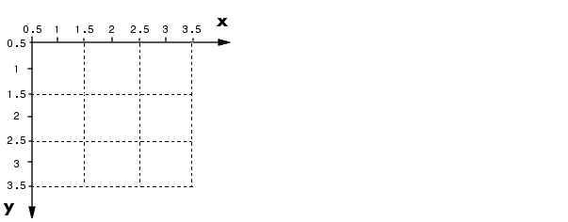
IMAGE Image Coordinate System:

Slide 11
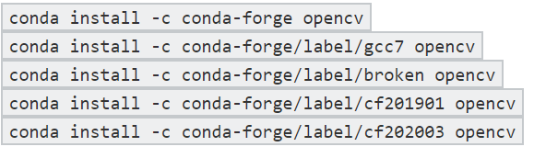
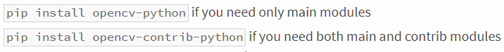
INSTALLATION
Installation using Anaconda
Installation using Python

Slide 12
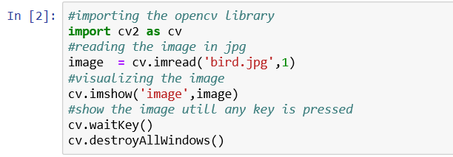
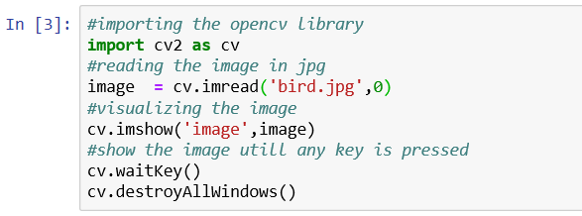
IMAGE PROCESSING Read and Show an image:
Read and Write a image in RGB
cv2.imread(‘input’, 1)
Here the 1 represents to read image in BGR
Read and Write image in Grayscale
cv2.imread(‘input’, 1)
Here the 0 represents to read image in Grayscale

Slide 13
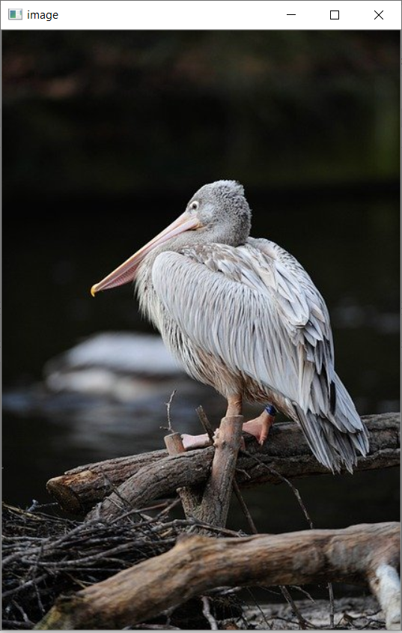
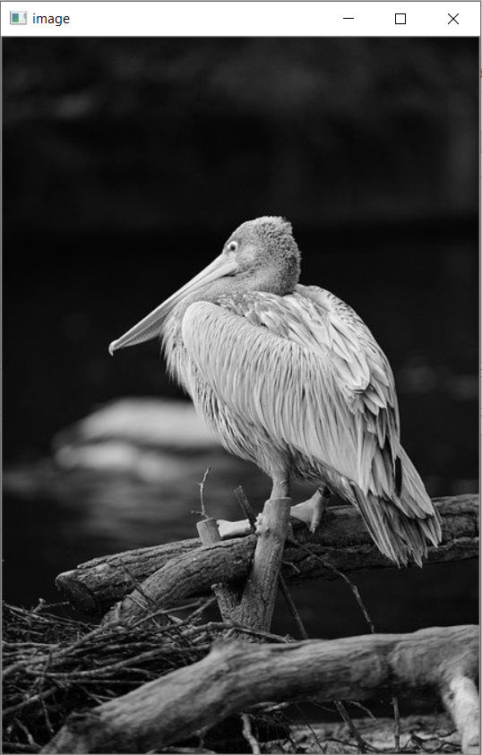
Read and Show an image:
Output
Output

Slide 14
IMAGE PROCESSING Geometric Shapes:
cv2.line - draw on image, a line from (0, 0) to (511, 511), with Color with the thickness of 5 px.
cv2.rectangle - draw a rectangle on image with (384, 0) as top-left and (510, 128) as bottom-right corner, with color and edge-thickness of 3px.
cv2.circle - draw a circle on image, with (447, 63) as center and radius of 63px, with RED (0, 0, 255) color, fully-filled in (-1).

Slide 15
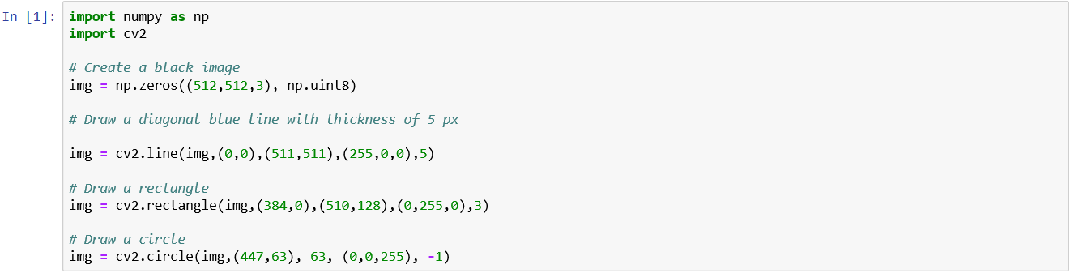
Geometric Shapes:

Slide 16
IMAGE PROCESSING Image Properties:
img.shape - The shape of the image is accessed. It returns a tuple of the number of rows, columns and channels (if image is color).
img.size - The total number of pixels is accessed.
img.dtype - Image datatype is obtained.
cv2.split(img) – The BGR channels of the image is split into individual planes.
cv2.merge((b,g,r)) – The individual channels can be merged to form the image.
ROI – The region of interest is used for the slicing of the image.

Slide 17
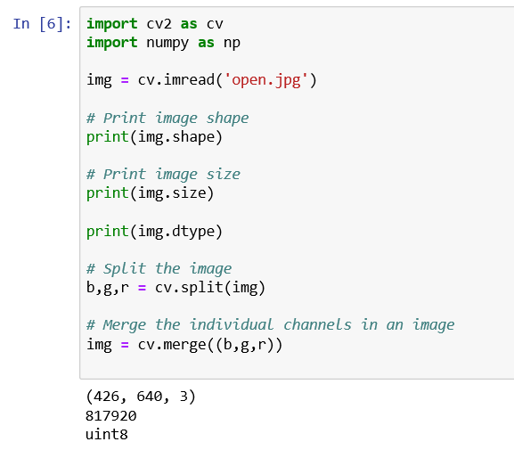
Image Properties:

Slide 18
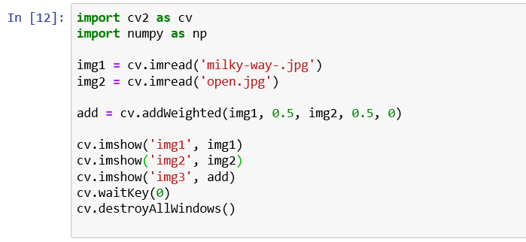
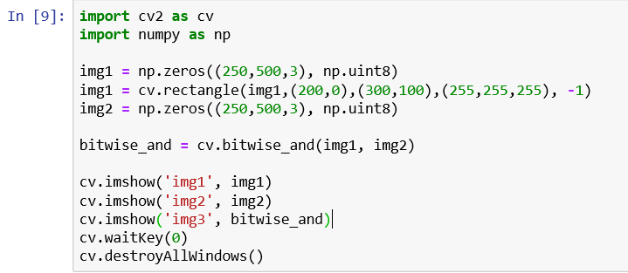
IMAGE PROCESSING Arithmetic Operations On Images:
Image Addition
Bitwise Operation

Slide 19
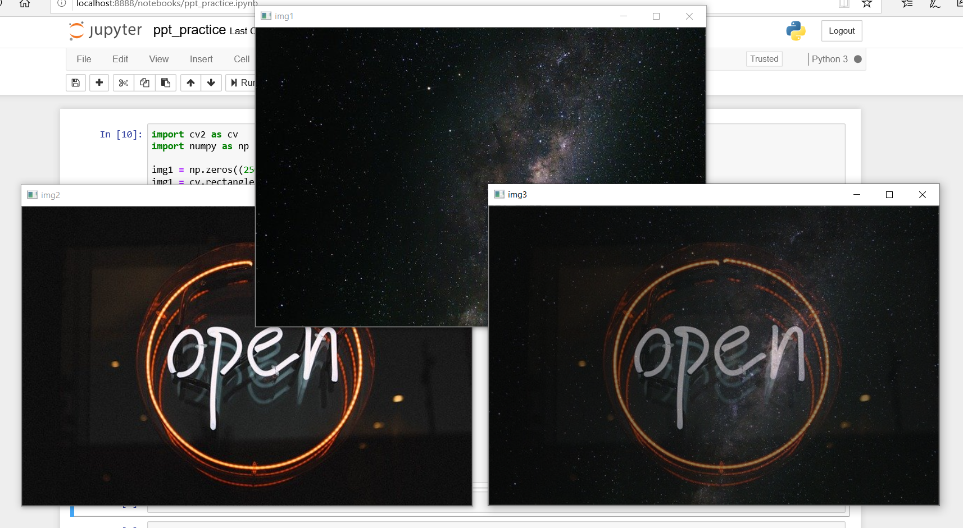
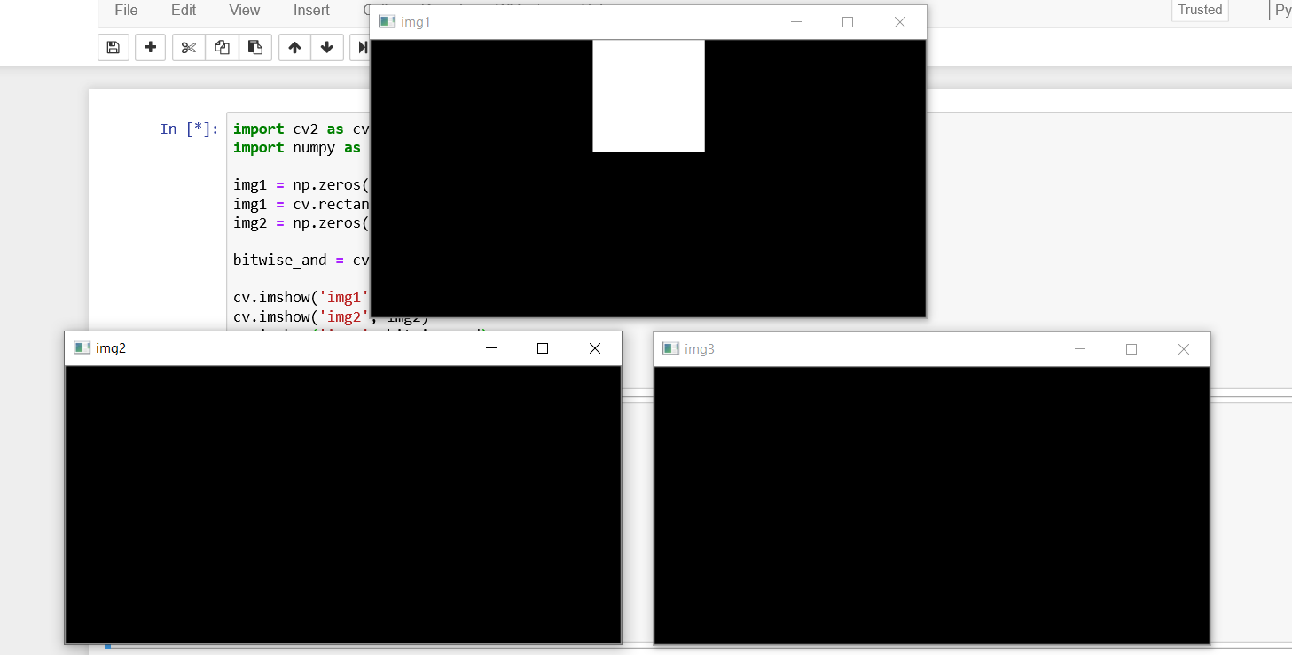
Arithmetic Operations On Images:
Output
Output

Slide 20
VIDEO PROCESSING Read and Show a Video:
cv2.VideoCapture() - object to capture the video. Returns True if video is read correctly.
cap.read() - returns a bool (True/False) value, whether the frame can be read or not. Second returned value (frame in this case) is the actual frame (if True)
cv2.cvtColor(frame, cv2.COLOR_BGR2GRAY) - this is our OpenCV operation where we are converting our frame from BGR to a grayscale frame.
cv2.VideoCapture("FILE_NAME.mp4")- instead of capturing from a camera, you can directly read the video file saved on your disk as well.

Slide 21
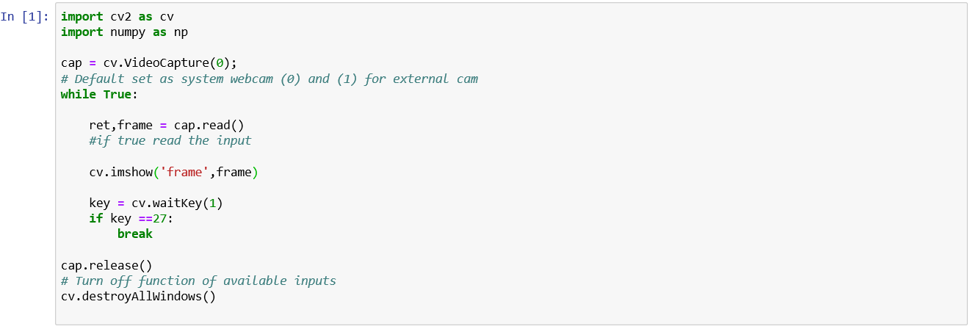
Read and Show a Video:

Slide 22
VIDEO PROCESSING Canny Edge Detector:
It is a popular edge detection algorithm.
It is a multi-stage algorithm and we will go through each stage.
Noise Reduction.
Since edge detection is susceptible to noise in the image, the first step is to remove the noise in the image with a 5x5 Gaussian filter.
Finds Intensity Gradient of the Image.
Performs Non-maximum Suppression - very important algorithm also used in DNN Object Detection algorithms.
Hysteresis Thresholding.

Slide 23
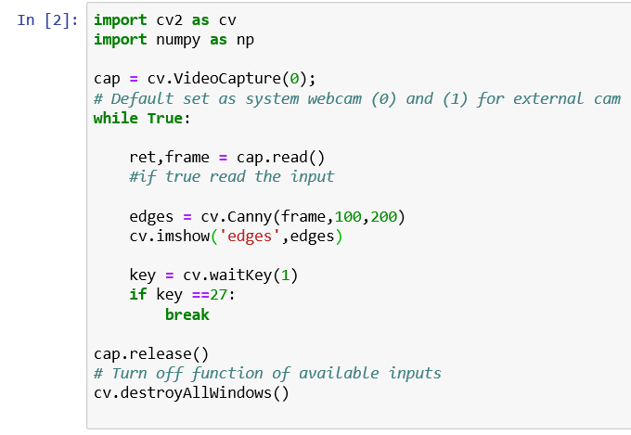
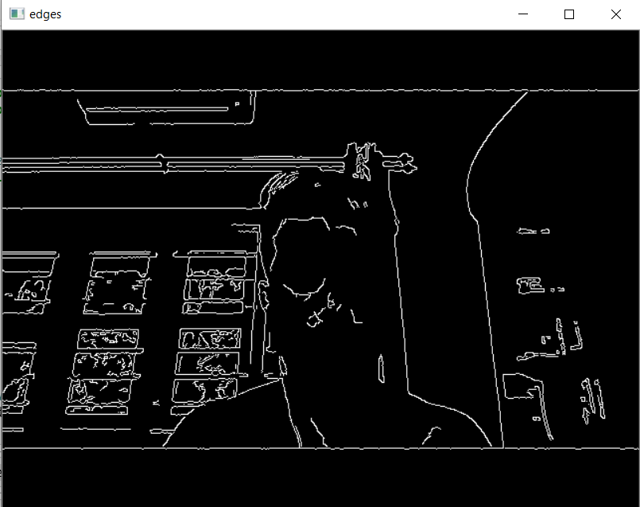
Canny Edge Detector:

Slide 24
VIDEO PROCESSING Background Subtraction:
Background subtraction is a way of eliminating the background from image. To achieve this we extract the moving foreground from the static background.
Background Subtraction has several use cases in everyday life, It is being used for object segmentation, security enhancement, pedestrian tracking, counting the number of visitors, number of vehicles in traffic etc. It is able to learn and identify the foreground mask.
In Python 2 - cv2.createBackgroundSubtractorMOG()
In Python 3 - cv2.createBackgroundSubtractorMOG2()

Slide 25
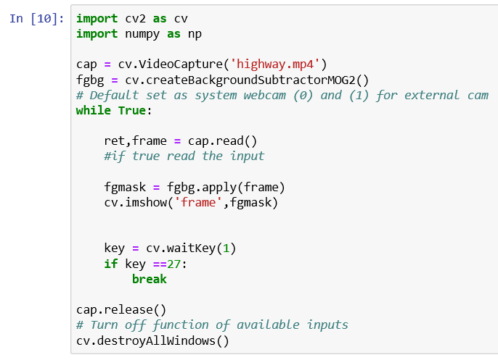
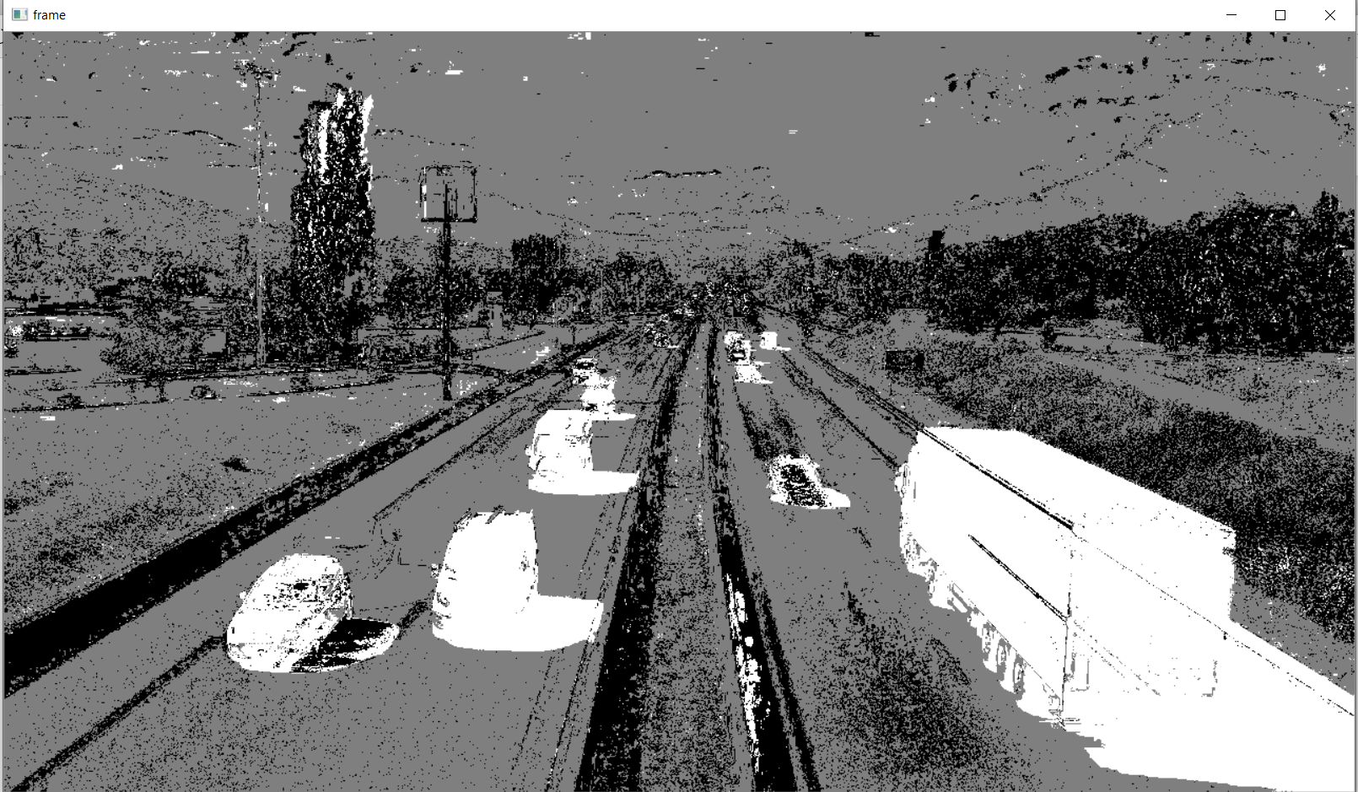
Background Subtraction:

Slide 26
VIDEO PROCESSING Object Tracking:
Now we know how to convert BGR image to HSV, we can use this to extract a colored object. In HSV, it is more easier to represent a color than in BGR color-space. In our application, we will try to extract a blue colored object. So here is the method:
Take each frame of the video.
Convert from BGR to HSV color-space.
We threshold the HSV image for a range of blue color.
Now extract the blue object alone, we can do whatever on that image we want.

Slide 27
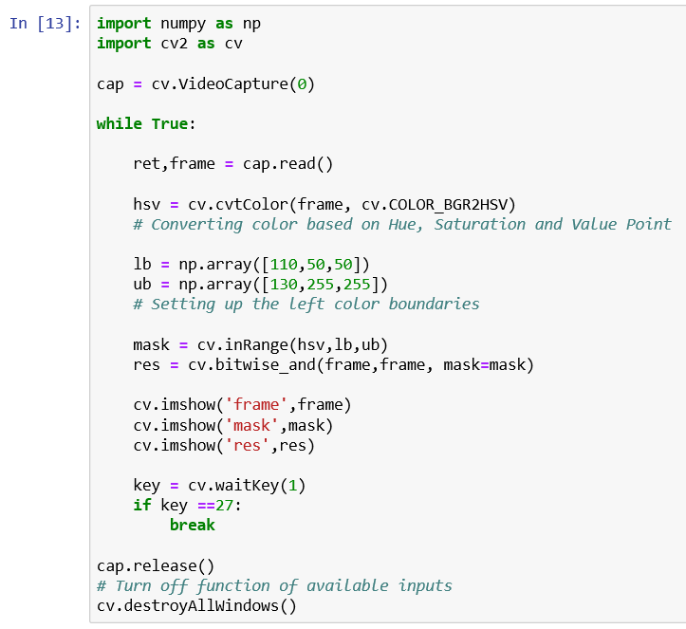
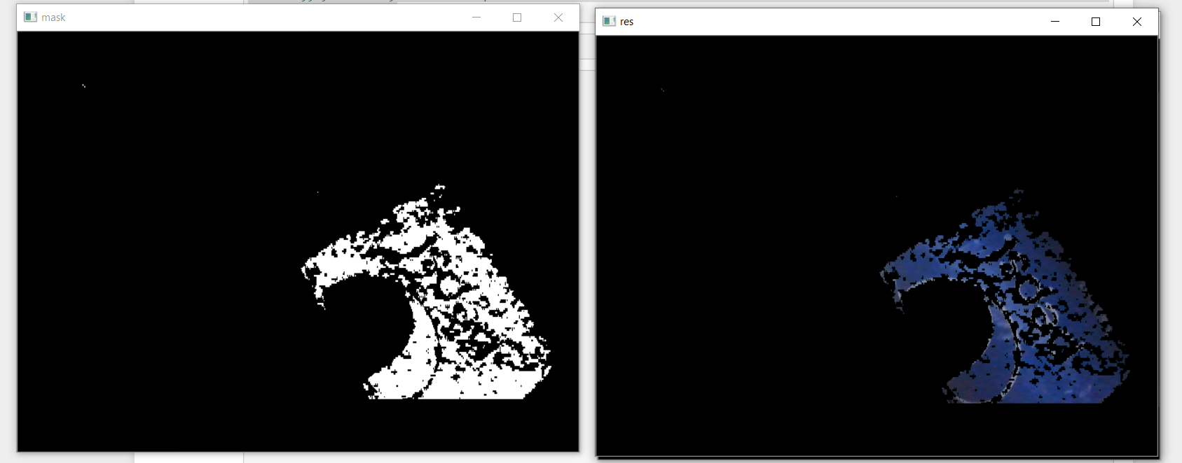
Object Tracking:

Slide 28
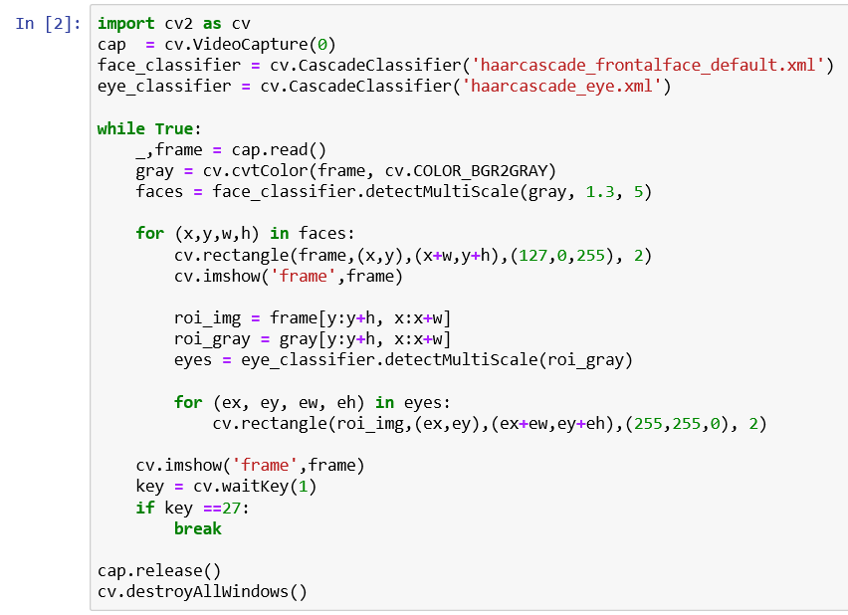
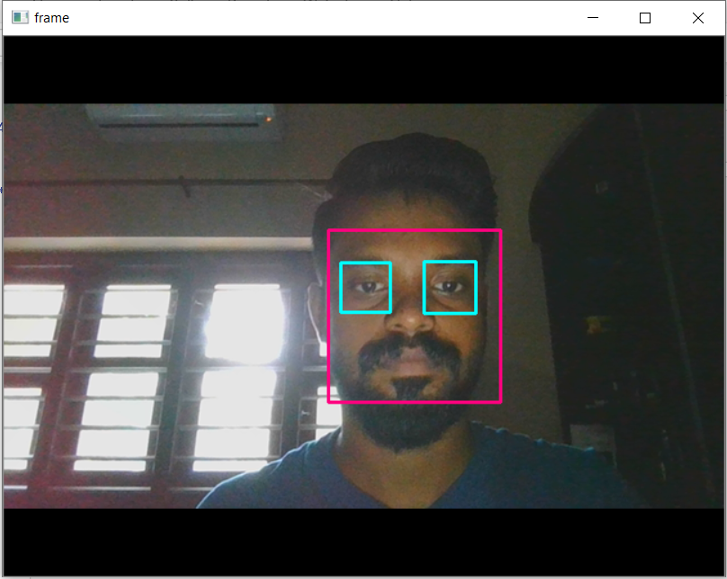
OBJECT DETECTION Face and Eye Detection Using HAAR Cascade:

Slide 29
REFERENCES
https://mlblr.com/includes/opencv/index.html#videos
https://www.youtube.com/watch?v=kdLM6AOd2vc&list=PLS1QulWo1RIa7D1O6skqDQ-JZ1GGHKK-K
https://www.youtube.com/watch?v=mT34_yu5pbg&list=PLZoTAELRMXVOIBRx0andphYJ7iakSg3Lk

